Slide 1


Forecasting Daily Restaurant Demand
Improving Operational Efficiency through Predictive Analytics

Slide 2

The Challenge of Unpredictable Demand
Restaurants face staffing and inventory issues due to uncertain customer volume
Manual planning is reactive and error-prone
A data-driven forecast model can enhance planning

Slide 3
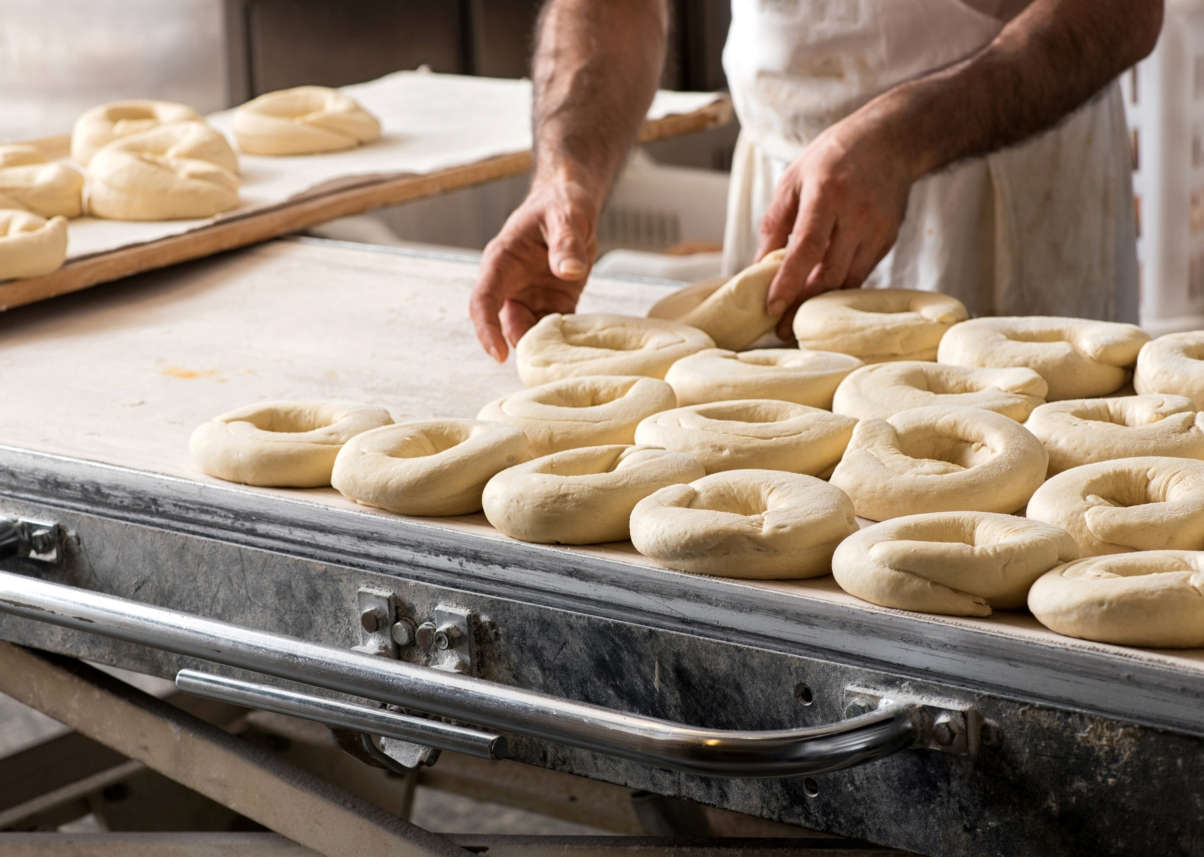

Why Forecasting Matters
Traditional methods: historical averages and intuition
Digital data creates opportunity for machine learning
Kaggle dataset enables real-world modeling

Slide 4

Data Overview
Visit records, reservations, calendar data, and restaurant metadata
Engineered features: lags, rolling means, reservation ratios
Target variable: daily customer count

Slide 5
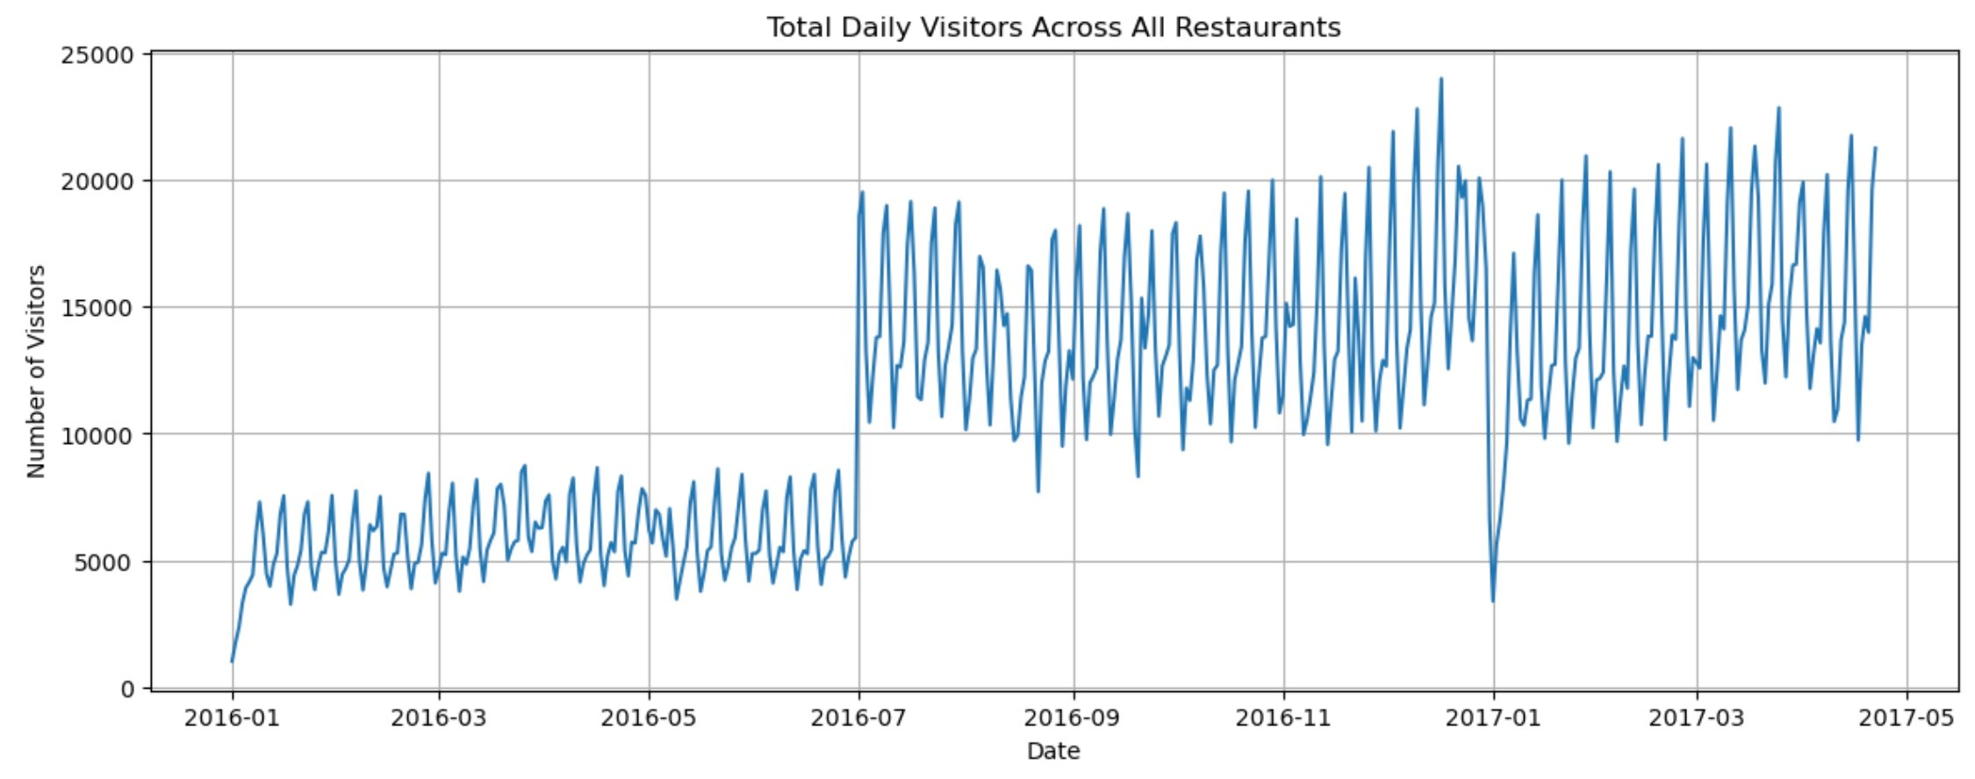
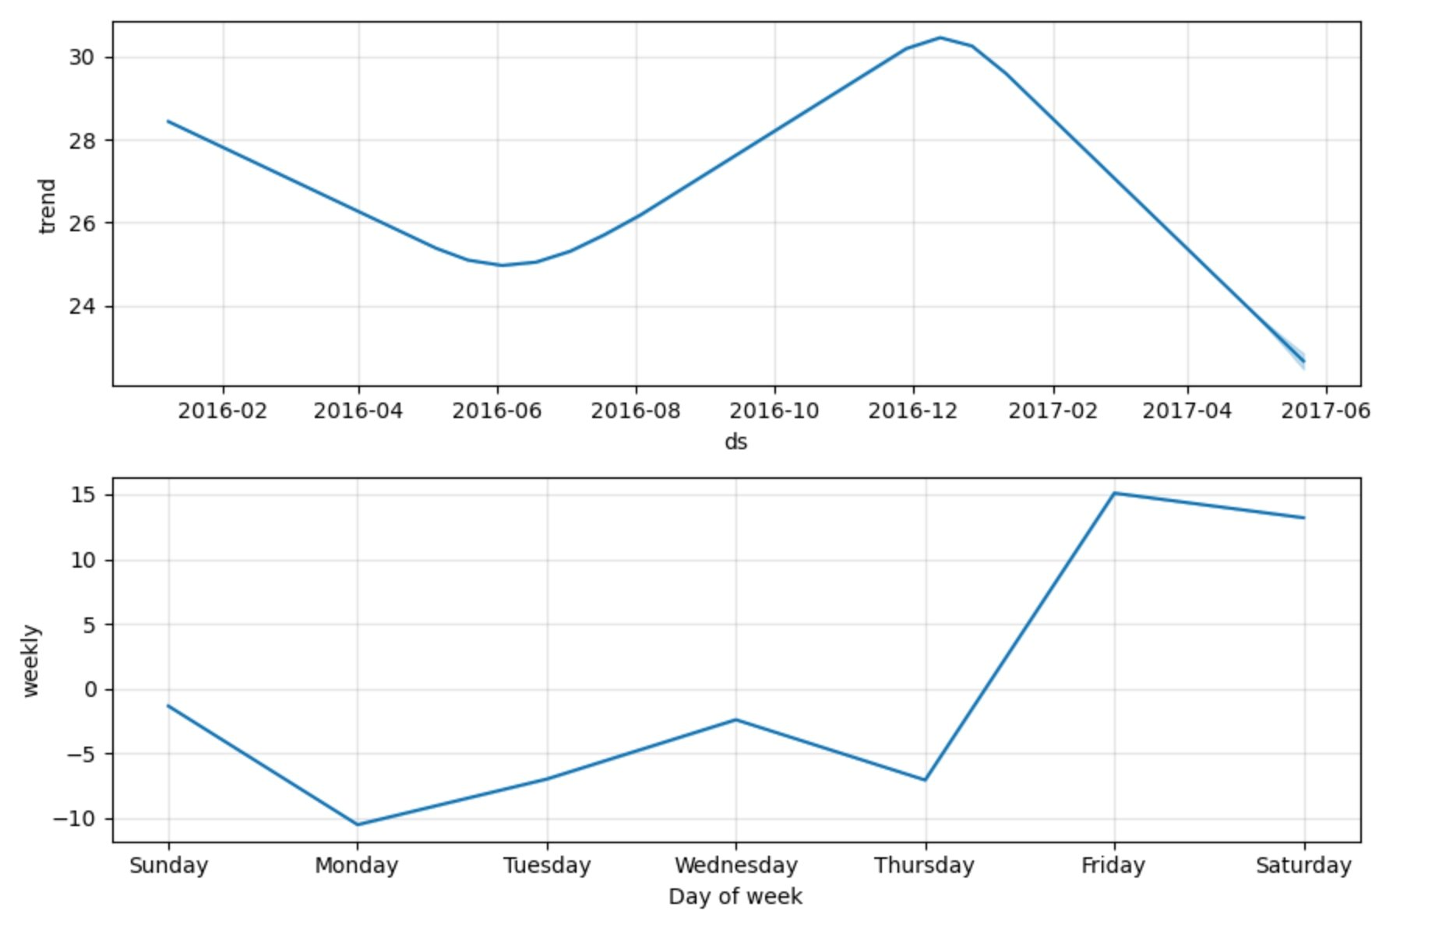
Visitor Trends Over Time
And Total Daily Visitors Across All Restaurants
Shows total customer volume trends
Weekly and seasonal fluctuations
Demand growth patterns

Slide 6
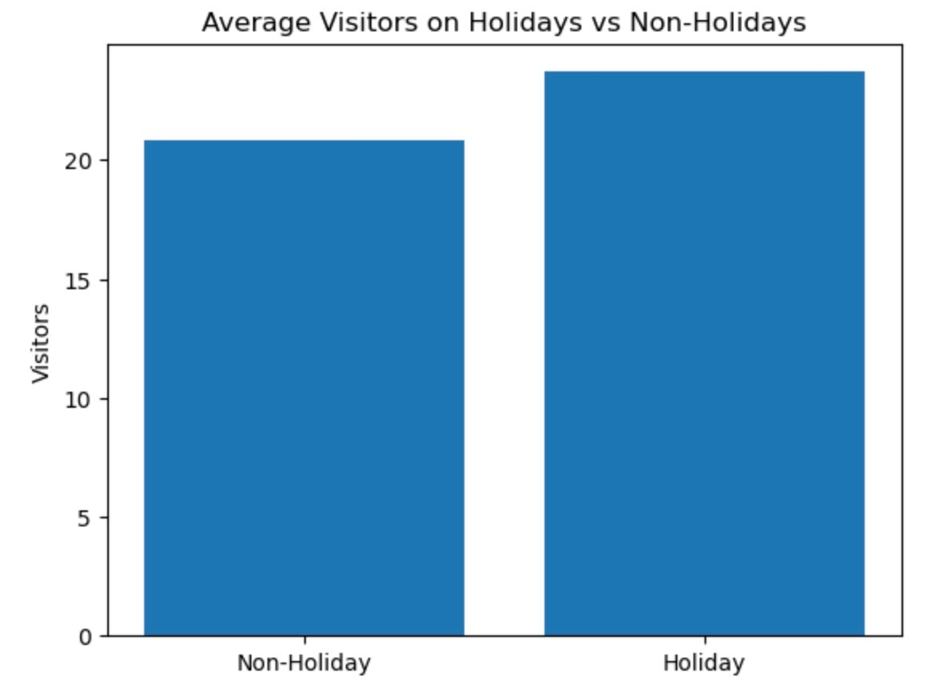
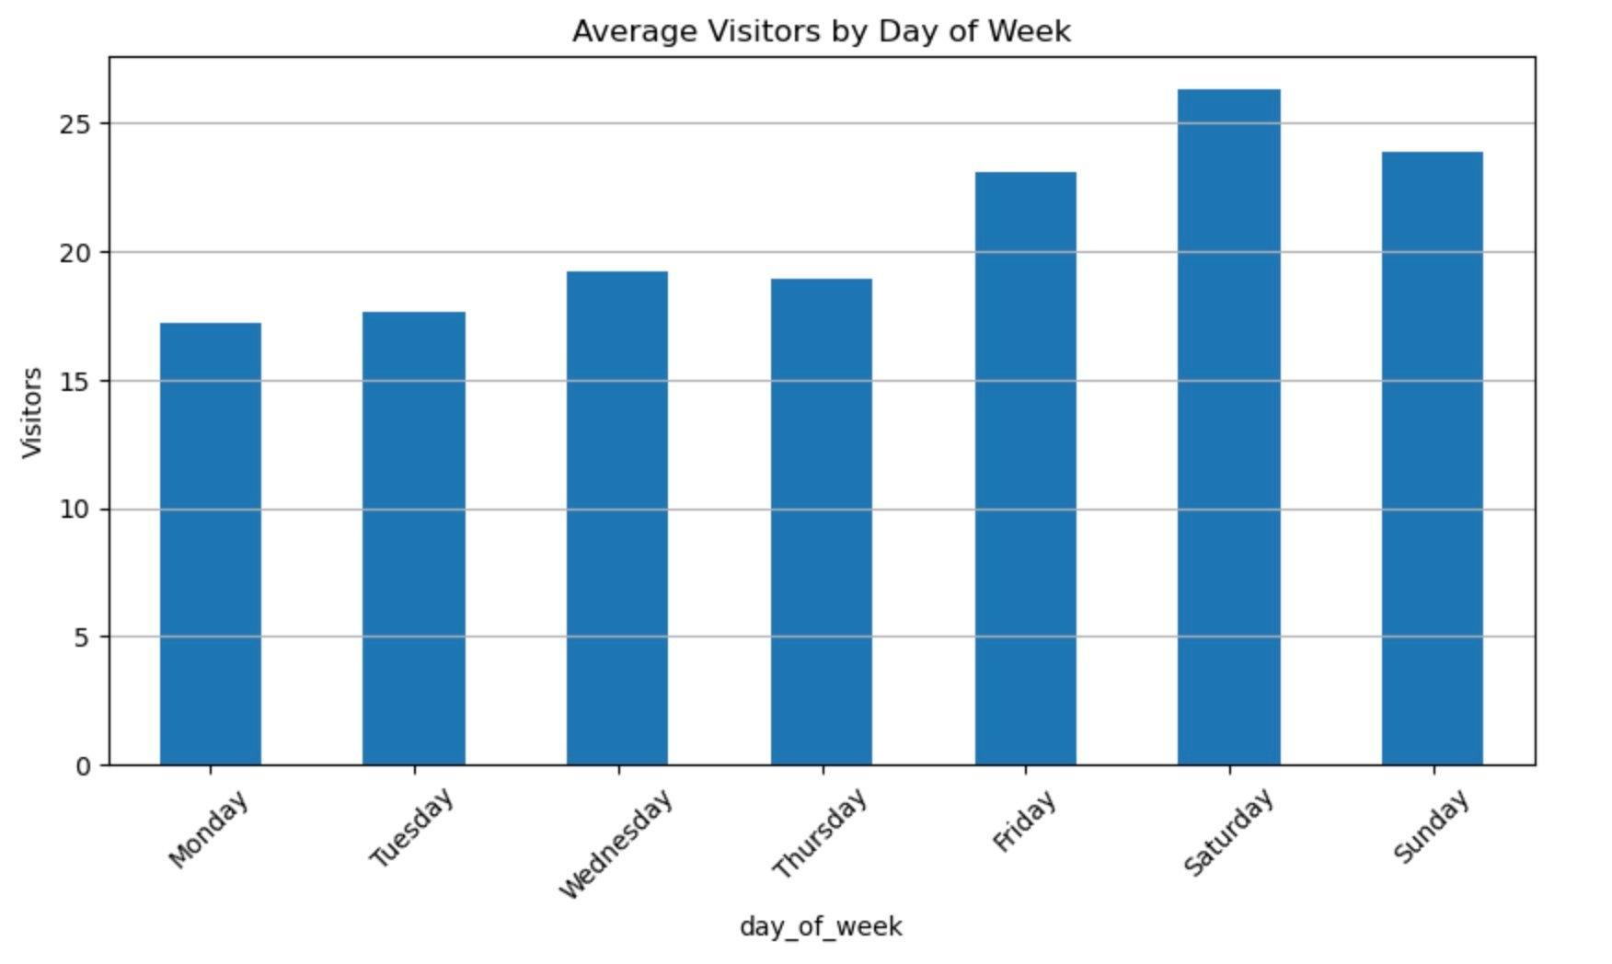
Weekly & Holiday Impact on Demand
Bar plot: higher traffic on weekends
Holidays elevate demand
Monday shows lowest average traffic

Slide 7
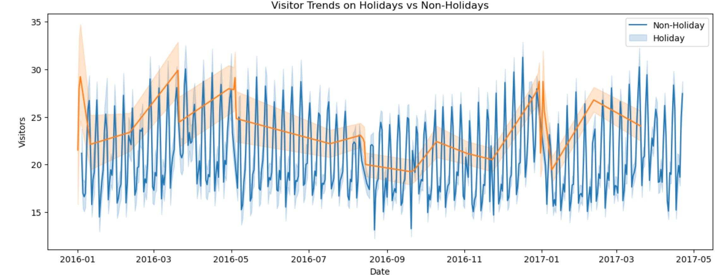
Demand Trends on
Holidays vs Non-Holidays
Overlay of demand during holidays vs normal days
Holidays create sustained spikes in visits

Slide 8
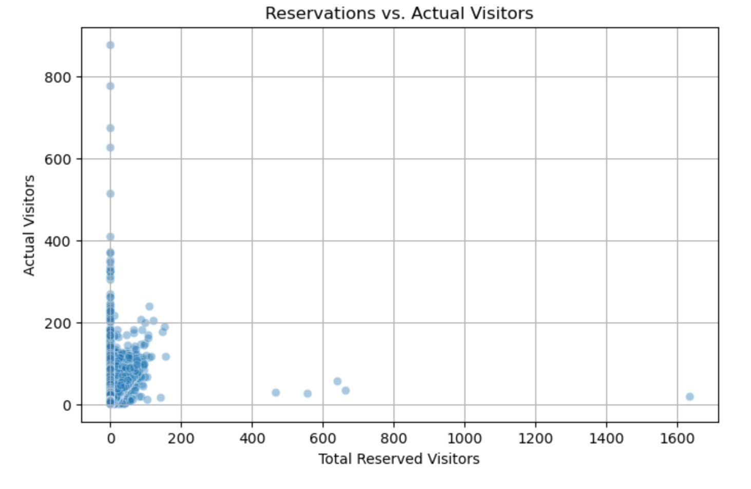
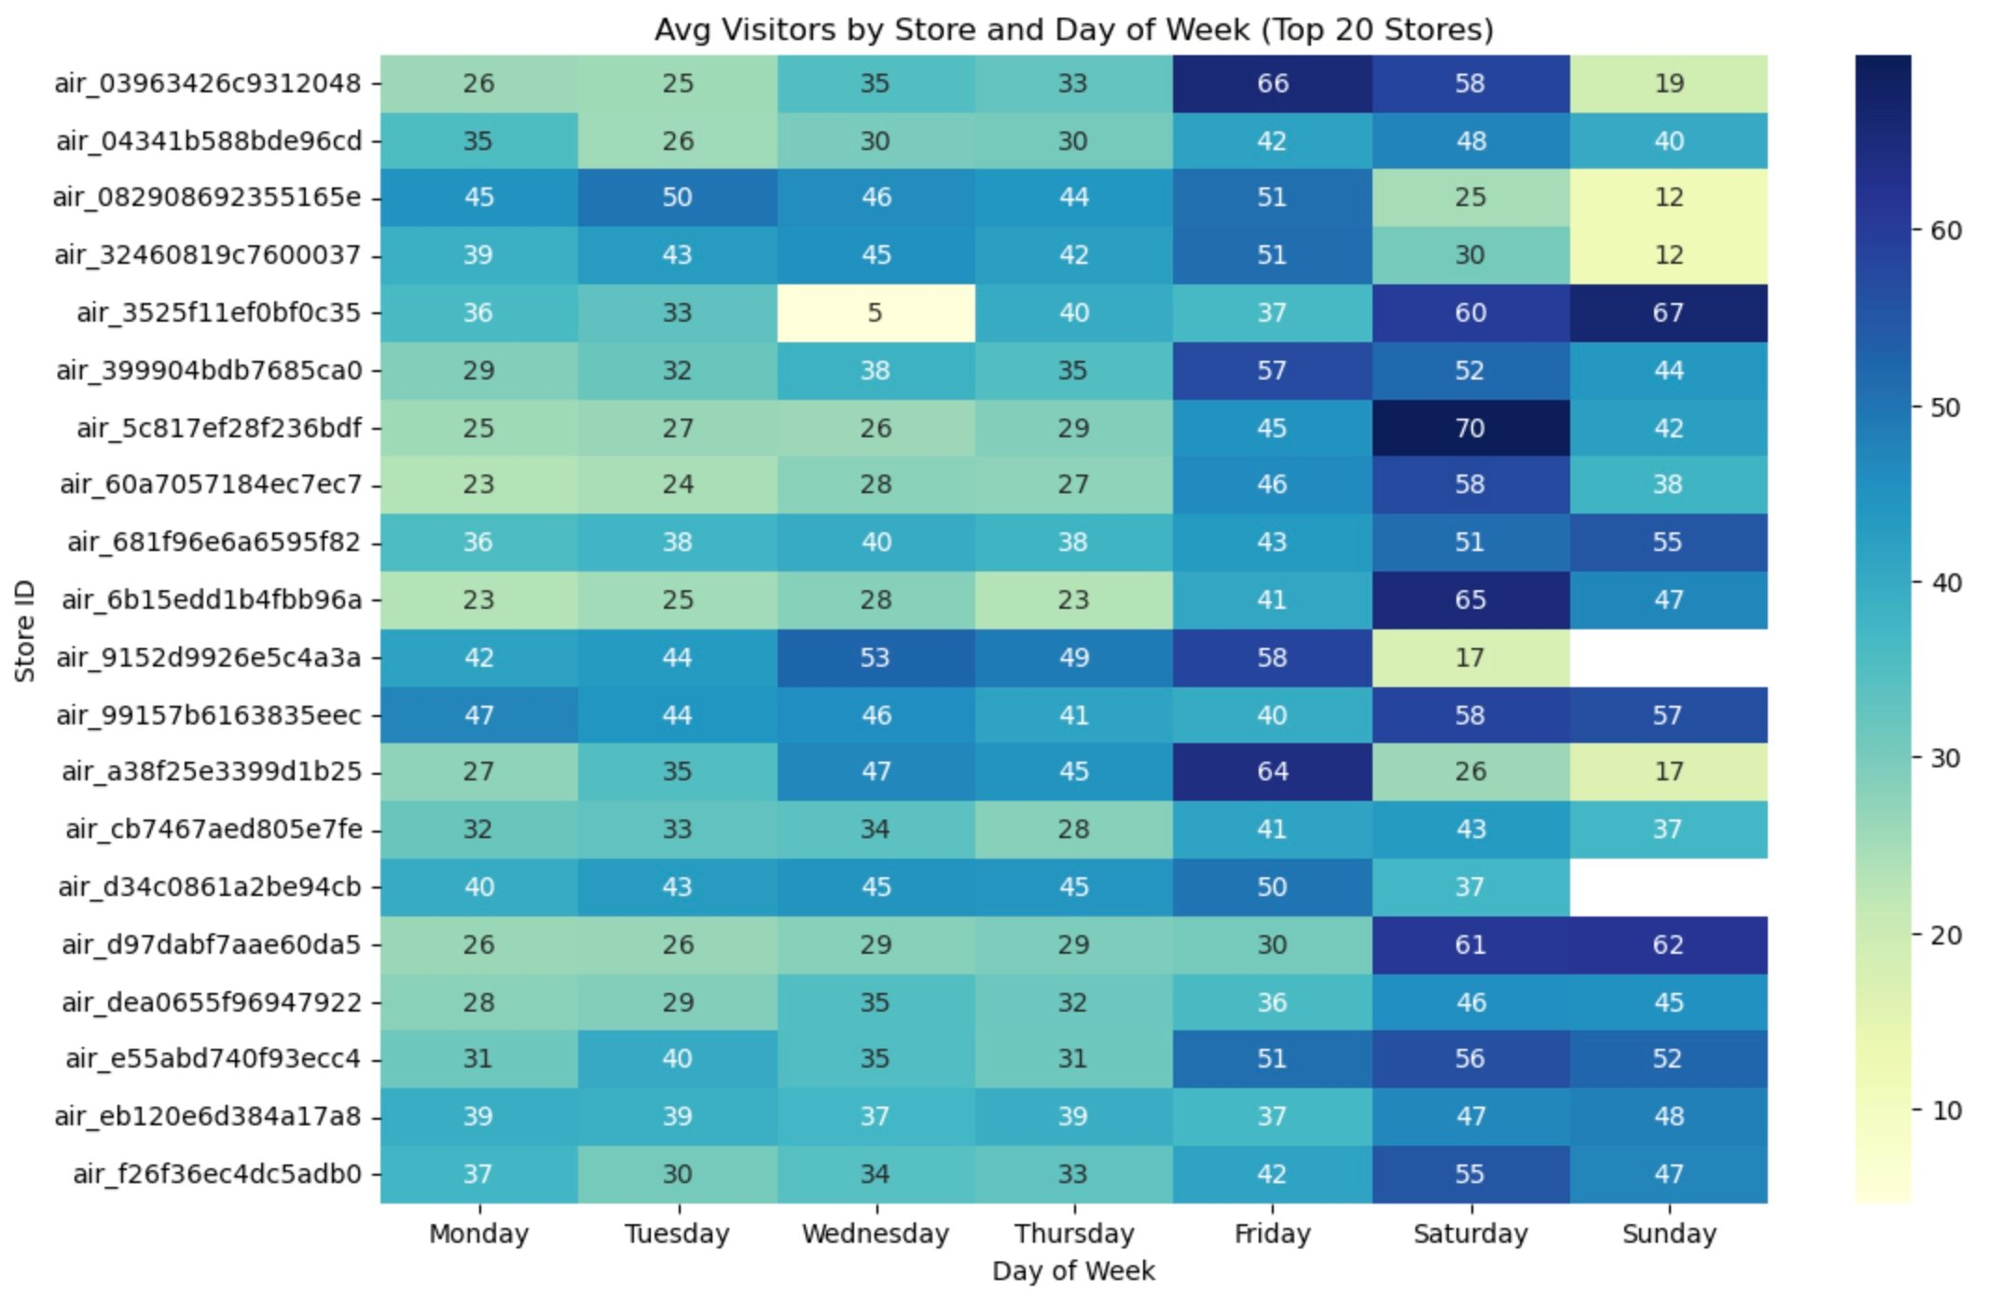
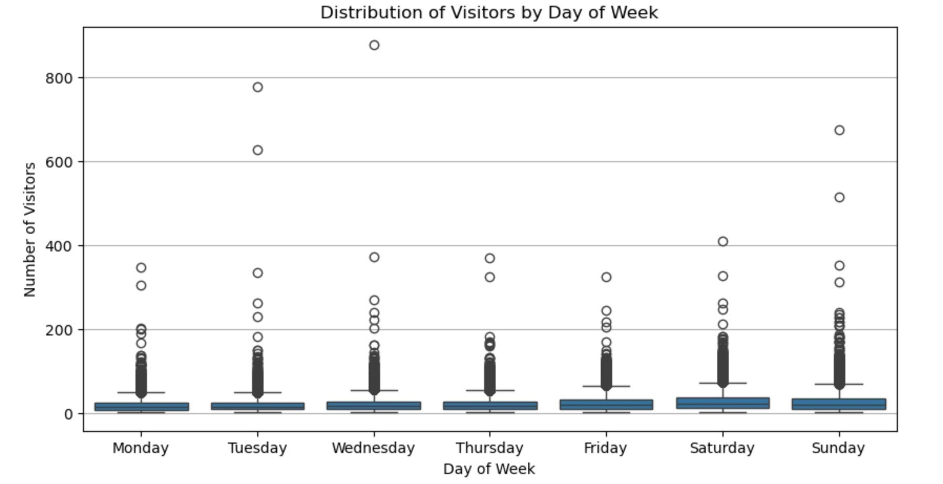
Store Behavior and Reservations
Heatmap: peak days vary by store
Scatter: reservations correlate with turnout
Boxplots show demand variability

Slide 9
Building the Forecasting Models
Baseline: Prophet (time series)
Advanced: XGBoost (multi-feature regression)
Evaluation: MAE and RMSE

Slide 10
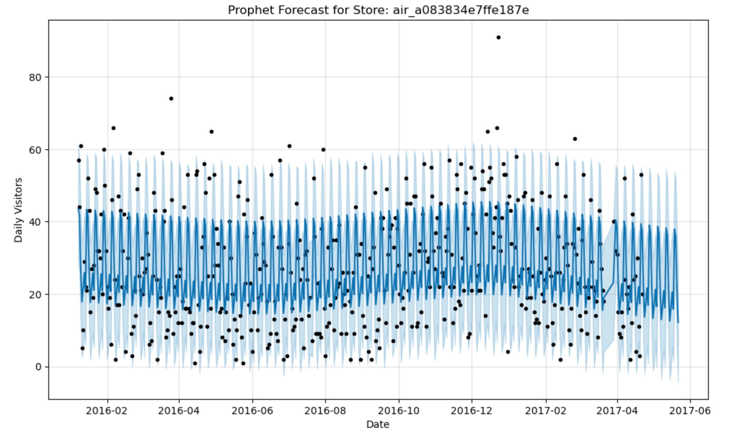
Prophet Forecast and Confidence Intervals
Forecast shows seasonality and trend
Wide intervals reflect uncertainty
Useful for long-term planning

Slide 11
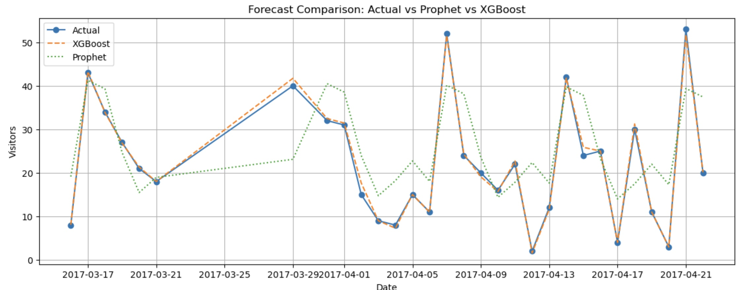
Forecast Accuracy: XGBoost vs Prophet
Overlay of predicted vs actual
XGBoost more closely tracks actuals
Prophet smooths over short-term variance

Slide 12
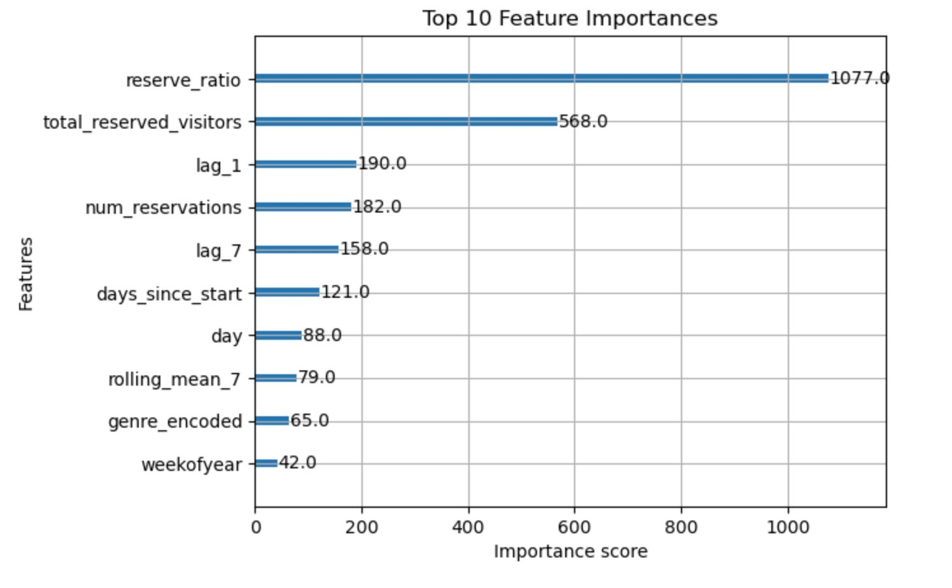
What Drives Demand: Feature Importance
Top features: reservations, lags, weekdays
Model interpretable and practical

Slide 13
Performance Metrics
Model | MAE | RMSE
Prophet | 8.59 | 10.04
XGBoost | 0.51 | 0.82

Slide 14
Recommendations- Making It Actionable
Deploy XGBoost for daily demand forecasting
Integrate API/dashboard into ops workflow
Automate data updates and model retraining

Slide 15

Limitations and Ethics - Responsible Use and Future Scope
Data only from Japan; external validity is limited
Missing external variables (weather, events)
Ethical risks: staff scheduling fairness, data privacy

Slide 16

Summary and Key Takeaways
XGBoost delivered highly accurate forecasts (MAE: 0.51, RMSE: 0.82)
Integrated multiple datasets: reservations, calendar, trends
Visual and statistical analysis informed feature engineering
Recommended model for operational deployment in restaurants

Slide 17

Why XGBoost over other ML models?
XGBoost handles tabular data well, offers feature importance, and performs better than linear or tree-only models.
How accurate is the reservation data?
We assumed it was clean but used aggregation and filtering to minimize noise.
Why Prophet as baseline?
It's interpretable and good at trends, ideal for benchmark comparison.
Can it generalize globally?
Yes, but retraining is needed with local data and behaviors.
Would weather improve it?
Likely yes—external variables like weather and events should boost accuracy.
Questions & Discussion

Slide 18
Hourly forecasting possible?
Yes, with finer-grain data like POS timestamps.
How to manage anomalies?
Incorporate external event calendars or anomaly detection layers.
Real-time usage feasible?
Yes, through an API and continuous training.
How often should we retrain?
Weekly or biweekly, depending on seasonality and data volatility.
What about ethical use?
Predictions should guide—not dictate—staffing. Fairness and transparency must bemaintained.
Questions & Discussion

Slide 19

THANK YOU
Vasavi Kullanakoppal
vkullanakoppal@my365.bellevue.edu

